Slide 1
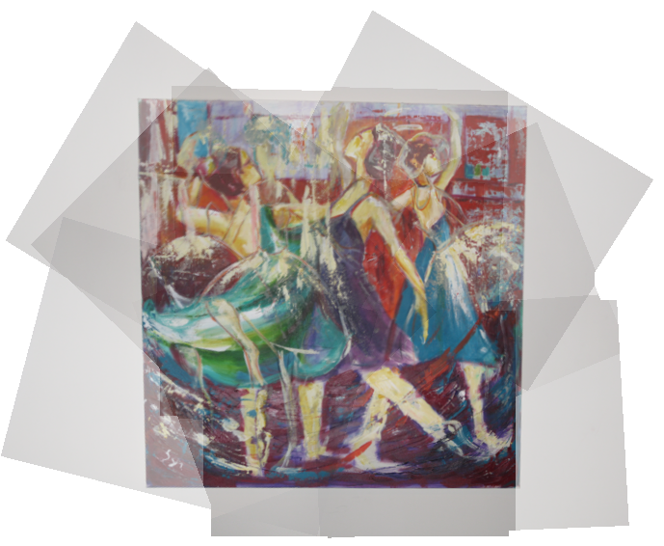
Computer vision

Slide 2
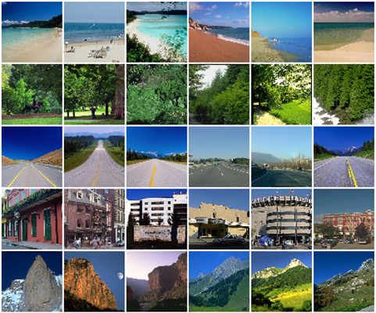

Visual Descriptors
Motivation::
Scene Classification
How to differentiate between scenes?
Applications and Algorithms in CV
Tutorial 9:
Descriptors
Introduction

Slide 3
Visual Descriptors:: Global descriptors
Naïve-st approach:: Primitive Global descriptors
Color expectancy:
Color variance:
Skewness:
Very Simple
Very-very limited
Applications and Algorithms in CV
Tutorial 9:
Descriptors
Introduction

Slide 4
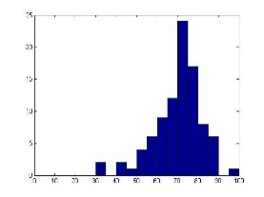
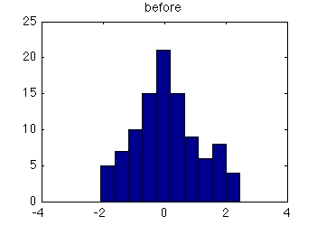
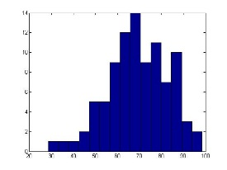
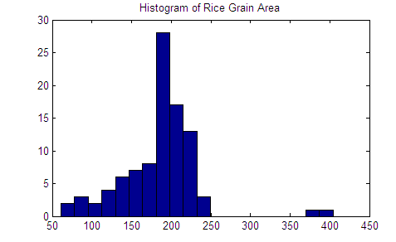
Visual Descriptors:: Global descriptors
Less but still naive:: Color Histogram
High invariance to many transformation
Limited discriminative power
Applications and Algorithms in CV
Tutorial 9:
Descriptors
Introduction

Slide 5
Visual Descriptors:: Global descriptors
Getting warmer:: Gist
“Observers recognize a real-world scene at a single glance”
Gist is a concept not a unique algorithm
*Gist = תמצית, תוכן, עיקר
Applications and Algorithms in CV
Tutorial 9:
Descriptors
Introduction

Slide 6
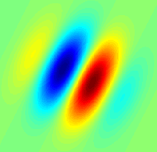
Visual Descriptors:: Global descriptors
Getting warmer:: Gist
“Observers recognize a real-world scene at a single glance”
Gist is a concept not a unique algorithm
Gist:: version #1
1. Partition image into a 4x4 grid
2. Filter each pixel with a sequence of (Gabor) filters
3. Express the total response of each cell
Example of a 2D Gabor filter
*Gist = תמצית, תוכן, עיקר
Applications and Algorithms in CV
Tutorial 9:
Descriptors
Introduction

Slide 7
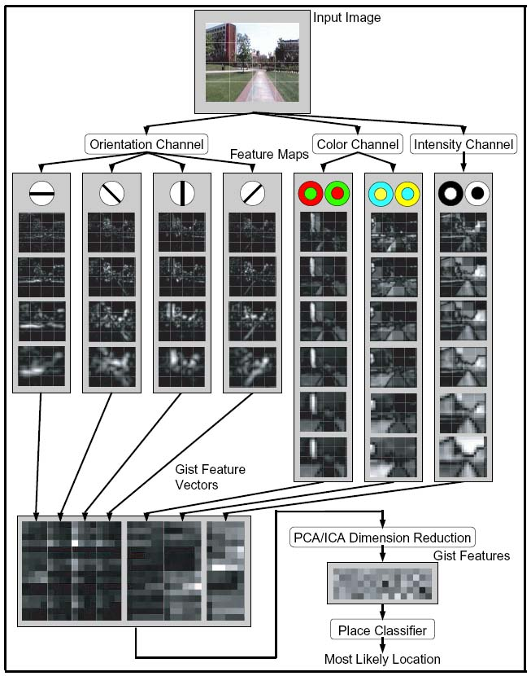
Visual Descriptors:: Global descriptors
Getting warmer:: Gist
“Observers recognize a real-world scene at a single glance”
Gist is a concept not a unique algorithm
Gist:: version #2
1. Partition image into a 4x4 grid
2. Calculate histograms in multiple orientation channels
3. Calculate color/intensity histograms for each cell
*Gist = תמצית, תוכן, עיקר
Applications and Algorithms in CV
Tutorial 9:
Descriptors
Introduction

Slide 8
Visual Descriptors:: Global descriptors
Getting warmer:: Gist
“Observers recognize a real-world scene at a single glance”
Gist is a concept not a unique algorithm
Gist:: Overall idea
Partition the image into coarse cells
Describe each cell w/ a common value
Treat the descriptor as a whole (keep the order of the cells)
Applications and Algorithms in CV
Tutorial 9:
Descriptors
Introduction

Slide 9
Visual Descriptors:: Global descriptors
We understand by now that global descriptors are very limited…
In many applications we need to describe images at a local scale based on local features
Applications and Algorithms in CV
Tutorial 9:
Descriptors
Introduction

Slide 10
Local Descriptors
Motivation::Detection
Would a global descriptor help us find the book (left image) in the right image?
Applications and Algorithms in CV
Tutorial 9:
Descriptors
Introduction

Slide 11
Visual Descriptors
Detection:: General Approach
Applications and Algorithms in CV
Tutorial 9:
Descriptors
Introduction

Slide 12
Visual Descriptors
Detection:: General Approach
1. Find a set of distinctive key-points
Applications and Algorithms in CV
Tutorial 7:
Descriptors
Introduction

Slide 13
Visual Descriptors
Detection:: General Approach
1. Find a set of distinctive key-points
Applications and Algorithms in CV
Tutorial 9:
Descriptors
Introduction

Slide 14
Visual Descriptors
Detection:: General Approach
1. Find a set of distinctive key-points
Applications and Algorithms in CV
Tutorial 9:
Descriptors
Introduction

Slide 15
Visual Descriptors
Detection:: General Approach
1. Find a set of distinctive key-points
2. Define a region around each keypoint
Applications and Algorithms in CV
Tutorial 9:
Descriptors
Introduction

Slide 16
Visual Descriptors
Detection:: General Approach
1. Find a set of distinctive key-points
2. Define a region around each keypoint
3. Compare regions
Applications and Algorithms in CV
Tutorial 9:
Descriptors
Introduction

Slide 17
Visual Descriptors
Detection:: General Approach
1. Find a set of distinctive key-points
2. Define a region around each keypoint
3. Compare regions
Different region appearance for different keypoints
Not a problem
Applications and Algorithms in CV
Tutorial 9:
Descriptors
Introduction

Slide 18
Visual Descriptors
Detection:: General Approach
1. Find a set of distinctive key-points
2. Define a region around each keypoint
3. Compare regions
Different region appearance for matching keypoints
Problem
Applications and Algorithms in CV
Tutorial 9:
Descriptors
Introduction

Slide 19
Visual Descriptors
The process illustrates 3 basic challenges in vision::
What to look at? (Keypoints)
How to find it? (detectors)
How to describe it? (descriptors)
Applications and Algorithms in CV
Tutorial 9:
Descriptors
Introduction

Slide 20
Visual Descriptors
Visual Descriptors:: are descriptions of the visual features of the contents in images or video. They describe elementary characteristics that are hopefully invariant over different appearances
What we need?
1. Description which is invariant to various transformations
2. Description which is distinctive for different keypoints
3. Description which is local, therefore robust to occlusion and clutter
Applications and Algorithms in CV
Tutorial 9:
Descriptors
Introduction

Slide 21
Visual Descriptors
Global vs. Local descriptors
The global image descriptor is being computed on the entire image
The local image description is founded on the premise that images can be characterized by attributes computed on regions of the image
Applications and Algorithms in CV
Tutorial 9:
Descriptors
Introduction

Slide 22
Visual Descriptors:: Local descriptors
The perfect local descriptor…
Will be invariant to:
1. Rotation
2. Translation
3. Scale changes
4. Illumination
5. Noise
Other transformations…
Applications and Algorithms in CV
Tutorial 9:
Descriptors
Introduction

Slide 23
Visual Descriptors:: Local descriptors
Simplest descriptor:: list of intensities within a patch
Write regions as vectors
Applications and Algorithms in CV
Tutorial 9:
Descriptors
Introduction

Slide 24
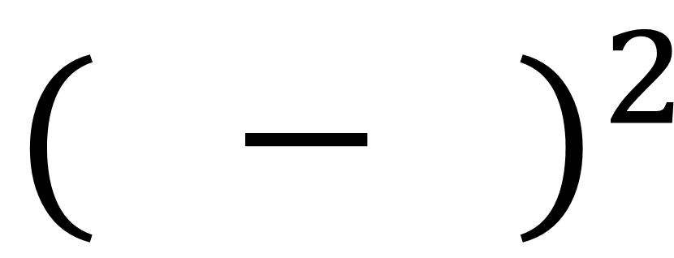
Visual Descriptors:: Local descriptors
Simplest descriptor:: list of intensities within a patch
Write regions as vectors
Match keypoints by measuring distance between vectors
$${( − )}^{2}$$
What is it going to be invariant to?
Applications and Algorithms in CV
Tutorial 9:
Descriptors
Introduction

Slide 25
Visual Descriptors:: Local descriptors
Simplest descriptor:: list of intensities within a patch
Write regions as vectors
Match keypoints by measuring distance between vectors
$${( − )}^{2}$$
What is it going to be invariant to?
Not much…
Small shifts can affect matching score a lot
Applications and Algorithms in CV
Tutorial 9:
Descriptors
Introduction

Slide 26
Visual Descriptors:: Local descriptors
Simplest descriptor:: list of intensities within a patch
Solution1:: Histogram of intensities
What is it going to be invariant to?
Applications and Algorithms in CV
Tutorial 9:
Descriptors
Introduction

Slide 27
Visual Descriptors:: Local descriptors
Simplest descriptor:: list of intensities within a patch
Solution2:: Histogram of gradients
Applications and Algorithms in CV
Tutorial 9:
Descriptors
Introduction

Slide 28
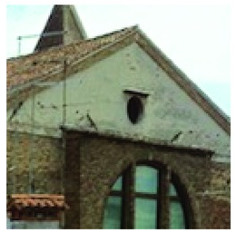
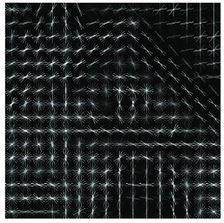
Visual Descriptors:: Local descriptors
Local Desc.:: HOG (Histogram of Oriented Gradients)
1. Partition an image into small squared cells
2. Compute a histogram of oriented gradients in each cell
3. Return a descriptor for each cell
HOG
8x8 cell size
Applications and Algorithms in CV
Tutorial 9:
Descriptors
Introduction

Slide 29
Visual Descriptors:: Local descriptors
Local (Detector &) Desc.:: SIFT (Scale Invariant Feature Transform)
Detect and describe local features in images
Select keypoints that are stable in scale space
Applications and Algorithms in CV
Tutorial 9:
Descriptors
Introduction

Slide 30
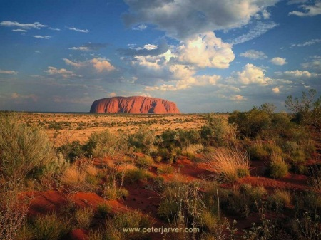

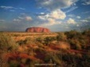
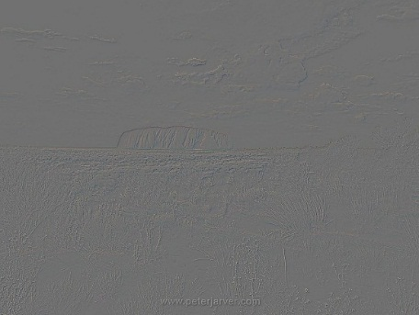
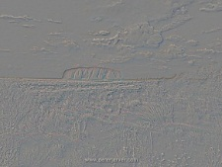
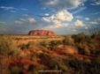
Recap:: Multi scale signal representation:: Bandpass Pyramids
Gaussian pyramid
W
Down-sample
W
Down-sample
Us-sample
Us-sample
Laplacian pyramid
Applications and Algorithms in CV
Tutorial 9:
Multi scale signal representation
Pyramids

Slide 31

Visual Descriptors:: Local descriptors
SIFT Detector
1. Scale-space extermum detection:: Candidate keypoints are defined as maxima and minima of the DoG applied in scale space
SCALE INVARIANT
Applications and Algorithms in CV
Tutorial 9:
Descriptors
Introduction
Scale invariant

Slide 32
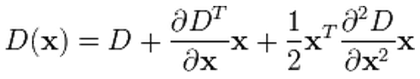
Visual Descriptors:: Local descriptors
SIFT Detector
2. Keypoint localization:: Compute a taylor expansion of the Dog around the candidate keypoint
The location of the extermum is determined by taking the derivative of the taylor expansion and setting it to zero
*The initial approach was just to locate each keypoint at the location and scale of the candidate keypoint, which resulted in poor performances
Applications and Algorithms in CV
Tutorial 9:
Descriptors
Introduction

Slide 33
Visual Descriptors:: Local descriptors
SIFT Detector
2.1 Reject low-contrast keypoints :: Discard of low-contrast keypoints by checking the value of the second order Taylor expansion at the offset
Applications and Algorithms in CV
Tutorial 9:
Descriptors
Introduction

Slide 34
Visual Descriptors:: Local descriptors
SIFT Detector
2.2 Reject edge-like keypoints:: We do that by solving the eigenvalues of the Hessian matrix.
Edge points are poorly located
Edge points have a much larger principal curvature across the edge than along the edge
Finding Principal curvatures amounts to finding the eigenvalues of the Hessien
Applications and Algorithms in CV
Tutorial 9:
Descriptors
Introduction

Slide 35
Visual Descriptors:: Local descriptors
SIFT Detector
3. Orientation assignment:: Compute gradient for each pixel in a region around the keypoint, and create a histogram of gradients (36 angle bins)
Each gradient is weighted by its magnitude
The peak of the histogram defines a dominant orientation
If more than one orientations exist (peaks that are within 80% of the highest peak), additional keypoints are created (same location, scale)
ROTATION INVARIANT
Applications and Algorithms in CV
Tutorial 9:
Descriptors
Introduction

Slide 36
Visual Descriptors:: Local descriptors
SIFT Descriptor::
1. Find the blurred image of the closest scale
2. Rotate the region by the dominant orientation
3. Divide the region into a 4x4 grid
4. Create a histogram for each cell (8 angels)
ILLUMINATION INVARIANT
5. Normalize the vector
(8 angels)x(4x4 grid) = 128 dimension descriptor
Applications and Algorithms in CV
Tutorial 9:
Descriptors
Introduction

Slide 37
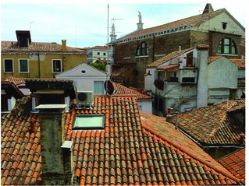
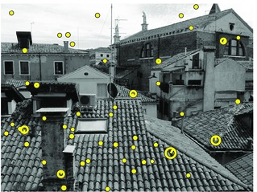
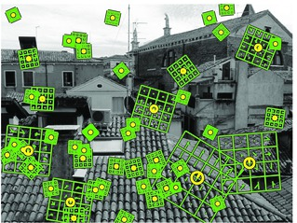
Visual Descriptors:: Local descriptors
SIFT Example
SIFT Detector
SIFT Descriptor
Original image
SIFT keypoints
SIFT descriptors
Applications and Algorithms in CV
Tutorial 9:
Descriptors
Introduction

Slide 38
Visual Descriptors:: Local descriptors
SIFT Summary
SCALE INVARIANT
1. Scale Invariance:: keypoints are located using scale-space representation
2. Rotation Invariance:: keypoints are aligned with dominant orientation
ROTATION INVARIANT
3. Illumination Invariance:: Sift descriptor vector is normalized
ILLUMINATION INVARIANT
Applications and Algorithms in CV
Tutorial 9:
Descriptors
Introduction

Slide 39
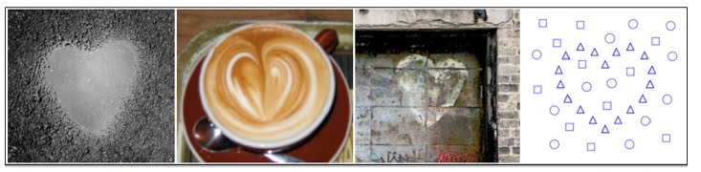
Visual Descriptors:: Local descriptors
Self-Similarity::
Images of the same object often do not share common image properties (e.g. color, texture)
Images of the same object do share a similar geometric layout of local internal self-similarities
Applications and Algorithms in CV
Tutorial 9:
Descriptors
Introduction

Slide 40
Visual Descriptors:: Local descriptors
Self-Similarity::
Self similarity descriptor overlook image properties and aims to extract the pattern that is shared between all appearances of the same object
Applications and Algorithms in CV
Tutorial 9:
Descriptors
Introduction

Slide 41

Visual Descriptors:: Local descriptors
Local “Self-Similarity descriptor”::
1. Extract a patch $P_{q}$ (typically 5x5) around pixel $q$
1. Extract a region $R_{q}$ (typically 40x40) around pixel $q$
Image patch
Image region
Applications and Algorithms in CV
Tutorial 9:
Descriptors
Introduction

Slide 42
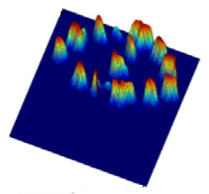
Visual Descriptors:: Local descriptors
Local “Self-Similarity descriptor”::
3. Compare $P_{q}$ with region $R_{q}$ using sum of squared differences
Image patch
Correlation surface
Image region
Applications and Algorithms in CV
Tutorial 9:
Descriptors
Introduction

Slide 43
Visual Descriptors:: Local descriptors
Local “Self-Similarity descriptor”::
4. Transform correlation surface $S_{q}(x,y)$ into log-polar coordinates centered at $q$, and partitioned into 80 bins (20 angles, 4 radial intervals). Select the maximal correlation value in each bin
Image patch
Correlation surface
Log-polar bins
Image region
Applications and Algorithms in CV
Tutorial 9:
Descriptors
Introduction

Slide 44
Visual Descriptors:: Local descriptors
Local “Self-Similarity descriptor”::
5. Flatten & normalize to get the final descriptor
Image patch
Correlation surface
Log-polar bins
descriptor
Image region
Applications and Algorithms in CV
Tutorial 9:
Descriptors
Introduction

Slide 45
Visual Descriptors:: Local descriptors
Matching global ensembles of local descriptors::
1. compute the local self similarity descriptors densely throughout F and G (compute every 5th pixel)
2. Filter out non-informative descriptors
descriptors that do not catch any local self-similarity
descriptors that contain high self similarity everywhere
Template F
Image G
Applications and Algorithms in CV
Tutorial 9:
Descriptors
Introduction

Slide 46
Visual Descriptors:: Local descriptors
Matching global ensembles of local descriptors::
All the local descriptors in F form together a global “ensemble of descriptors”
A good match of F in G corresponds to finding a similar ensemble of descriptors in G
3. Find a good match using an “ensemble matching” algorithm
SSIM
Template F
Image G
Applications and Algorithms in CV
Tutorial 9:
Descriptors
Introduction

